Slide 1
Prussing School Continuous Improvement Work Plan (CIWP) and School Budget Presentation
FY 2016 - 2017

Slide 2
Prussing CIWP Priorities
CIWP Framework Priorities:
Curriculum
Instructional Materials
Balanced Assessment and Grading

Slide 3
Prussing CIWP Strategies
CIWP Strategies:
Align literacy materials horizontally and vertically according to the CPS Content Framework/scope and sequence in grades K-8 with language and technology supports
Implement consistent, weighted averages in grade level clusters with grading and assessment
Utilize common diagnostic tools and professional development to assess student strengths and weaknesses to drive instruction and also support behavioral interventions
Implement more rigorous assessments that are tied to Common Core State Standards in Literacy

Slide 4
Prussing CIWP Strategies
CIWP Strategies:
Align the social studies curriculum and materials to the CPS Social Science 3.0 Framework with an emphasis on global awareness and the science curriculum with the Next Generation Science Standards
Teachers will construct language objectives based on data driven decision making to support English Language Learners
Provide teachers with professional development for developing differentiated activities that are based on the student proficiency levels, language domain, and language demands.

Slide 5
FY17
CPS Budget Overview
July 13, 2016

Slide 6
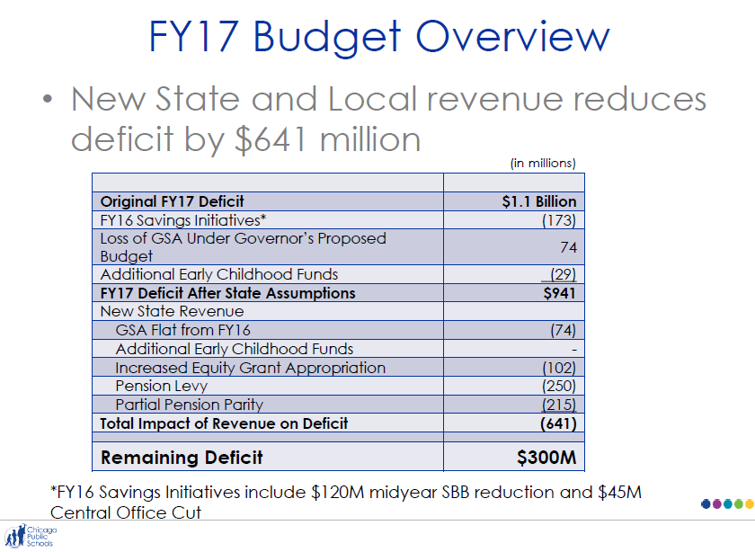

Slide 7
FY17 Budget Overview
• FY 17 budgets:
– No additional cuts
• Midyear cut is annualized and reflected in the
total budget amount
– One allocation for SBB and DL
• Unlike past years, DL funds will be included in
your budget total, not disbursed centrally
– The DL dollar amount was determined by your actual FY 16 spend
• SBB allocation reflects the same formula used
in the past, updated with FY 17 rates

Slide 8
What it Means to Prussing
The mid-year cuts to the SBB Allocation 2016 is the new baseline; roughly 5% less than original 2016 allocation.
SBB (115) & Diverse Learner (114) Decrease | -$146,062
SGSA (225) Decrease | -$10,916
SGSA (225) Rollover | +$41,022
Title I Discretionary (332) | -$37,286
Title I Parent Involvement (332) | -$1,135
Title II | +$102,000
Total Net Decrease | -$52,377

Slide 9
What it Means to Prussing
Priorities as stipulated by the CIWP:
Focus on delivering Core Curriculum aligned with CCSS standards
Focus on improving Teaching & Learning strategies
Focus on supporting learning growth for ALL students (e.g. Diverse Learners, English Language Learners, etc.
Additional Priorities:
After School Program Funding (i.e. academic support and social clubs)
Sports Funding
Focus on Teacher Collaboration and Professional Development
Instructional Materials and Equipment

Slide 10
What it Means to Prussing
CIWP Priorities Honored and Respected:
All positions maintained
New Literacy Curriculum for school
Additional support for Social Emotional Learning through i3 grant
New technology in the building
Increase Staff Development Opportunities

Slide 11
What it Means to Prussing
Curriculum and Instructional Practices
Increased support for critical thinking in Reading and Mathematics
Cohesive, CCSS aligned Reading and Math programs with necessary support material for students in K-8
Focus on Reading and Writing as necessary components for success for students (e.g. ThinkCerca & Reading in Motion)
Opportunities to improve instructional practices through peer observation and collaboration

Slide 12
What it Means to Prussing
Enrichment and Support Programs
International focus throughout the school
Continuation of Extended Day Academic and Extra-curricular Programs for students after school
Continuation of Sports Programs at Prussing

Slide 13
Questions and Comments

